Slide 1
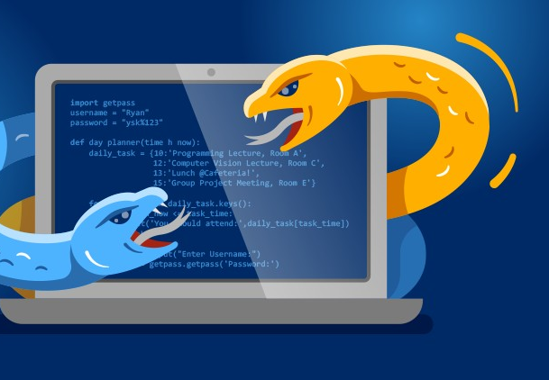

Python Expert
By Yilmaz Mustafa

Slide 2
